Slide 1
Dancing robot
CS560
Yaohan Teng 00807306

Slide 2
1. abstract:
(1) Purpose:
Implement a dancing robot using opengl
every parts of the robot can move automatically according to the time
(2) Knowledge I used :
GLUquadricObj
lighting things
glTranslate, glRotate
gluLookat …

Slide 3
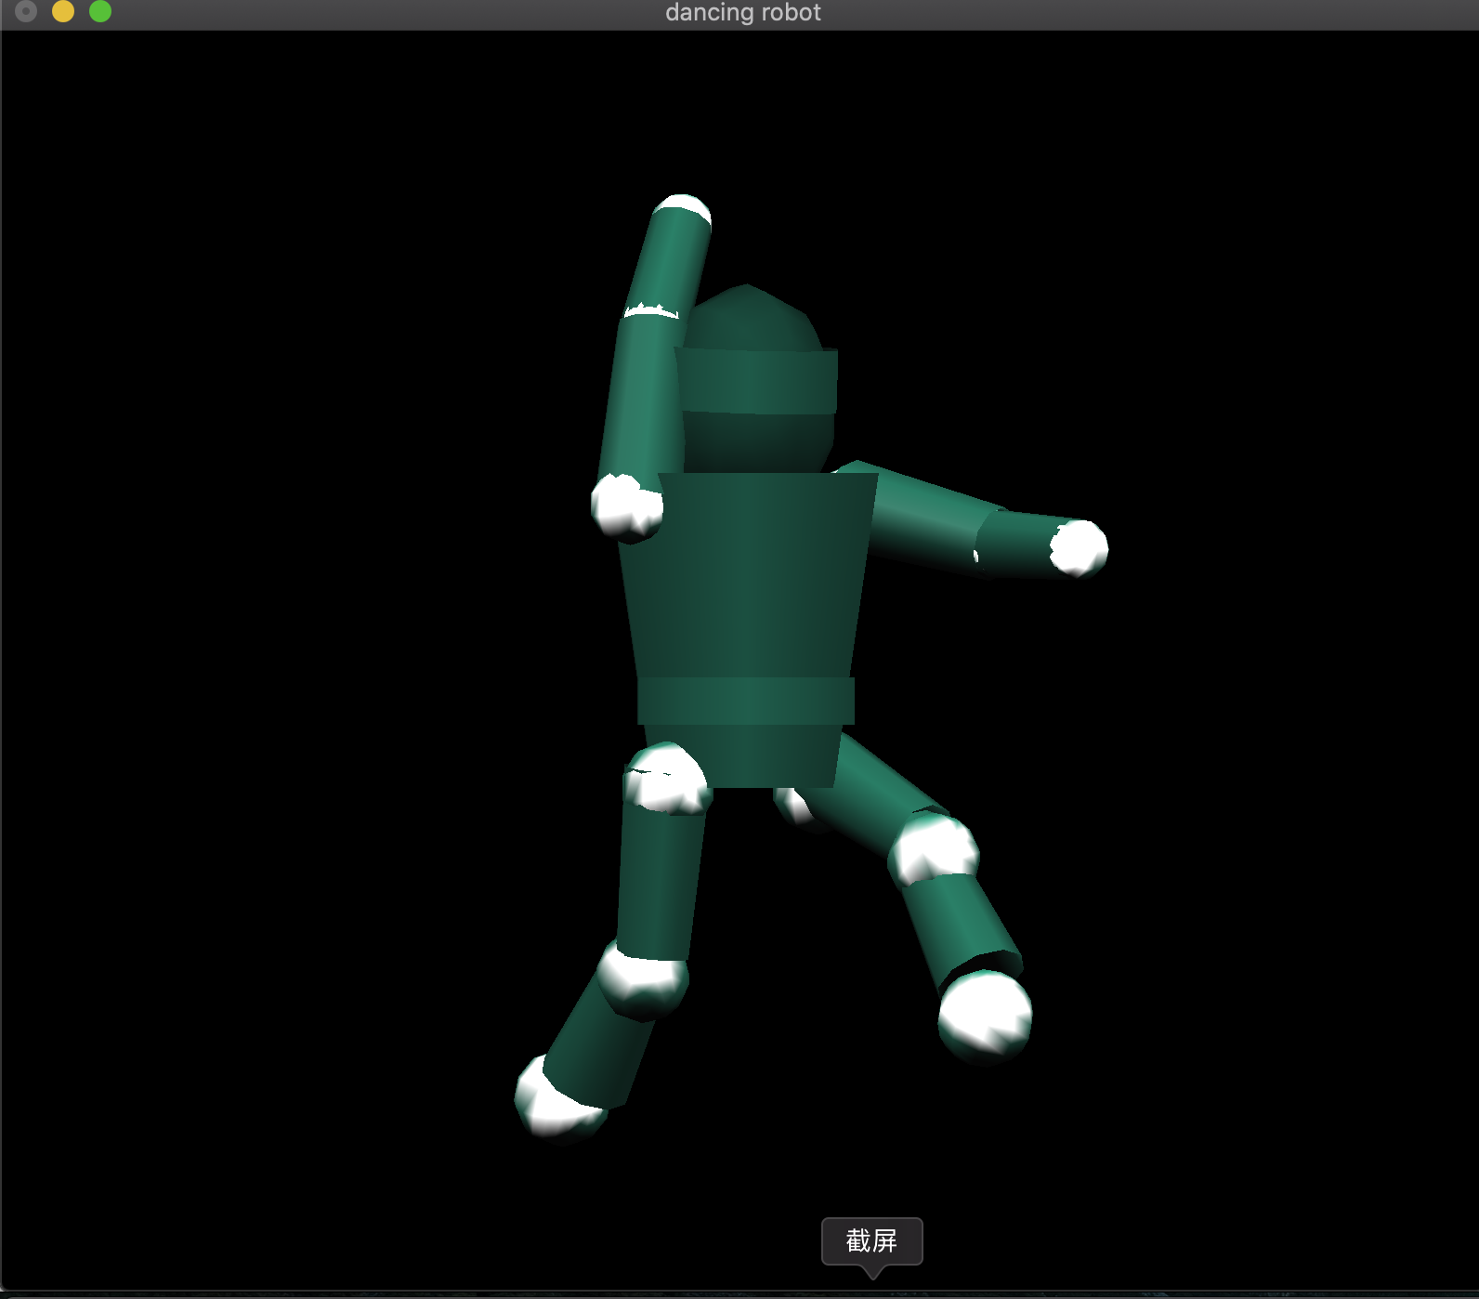
examples

Slide 4
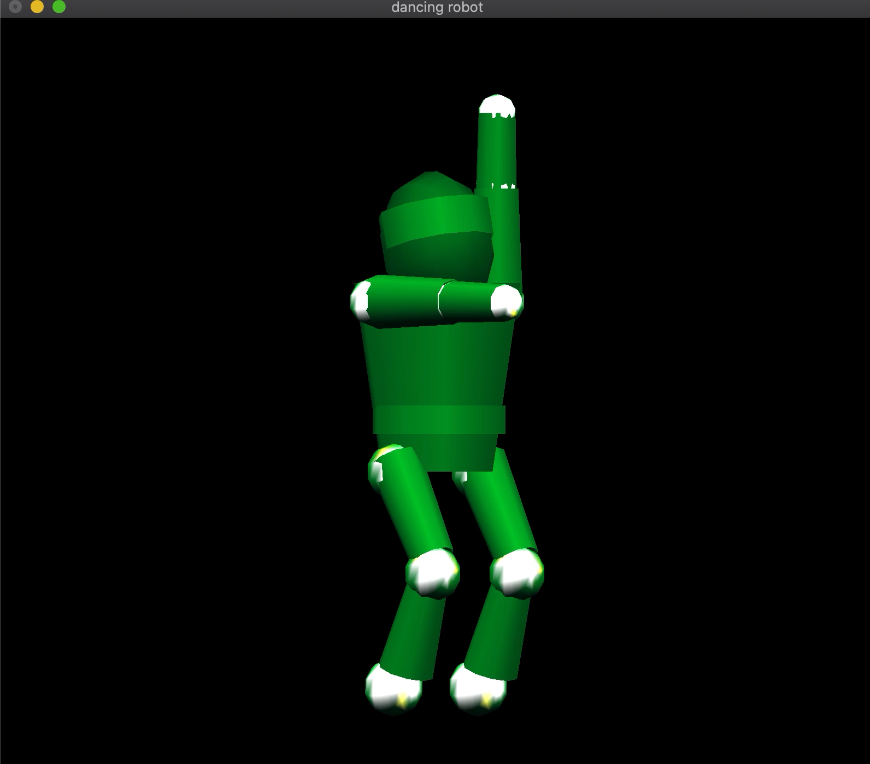

Slide 5
(1) init objects for every parts of the robot
GLUquadricObj*t, /// body
*h, /// head
*lua, /// left upper aram
*lla, /// left lower aram
*rua, /// right upper aram
*rla, /// right lower aram
*lul, /// left upper leg
*rul, /// right upper leg
*lll, /// left lower leg
*rll; /// right lower leg

Slide 6
(2) Build body parts:
gluCylinder(). →{
gluSphere() →{ to build body parts

Slide 7
(3) Combine body parts together
glTranslate
glRotate

Slide 8
(4) random choose arguments for light:
srand(time(NULL));
mat_specular[0] = (rand()% 10) * 0.09;
mat_specular[1] = (rand()% 10) * 0.06;
mat_specular[2] = (rand()% 10) * 0.03;
mat_ambient[0] = (rand()% 10) * 0.09;
mat_ambient[1] = (rand()% 10) * 0.06;
mat_ambient[2] = (rand()% 10) * 0.03;
mat_diffuse[0] = (rand()% 10) * 0.09;
mat_diffuse[1] = (rand()% 10) * 0.06;
mat_diffuse[2] = (rand()% 10) * 0.03;

Slide 9
(5) Arguments of rotation angles:
(i) frequency: frequency of rotation.
(ii) max and min : scope of rotation.
(6) Get rotation angle of each body parts:
float getAngle(float freq, float min, float max, float time){
return (max-min) * sin(freq * PI * time) + 0.5 * (max + min);
}

Slide 10
(7) Idle function:
getAngle() in idle(void)
glutIdleFunc(idle) to call the idle() ,
In this way we can use the time change to make the robot dancing automatically.

Slide 11
(8) Implement multiple dancing style:
Change the axis which each body parts rotate by, including x, y and z axis.
Use a integer variable called flag_dance to control it.
In glRotate(), we can set each axis to 0 or 1 , then we can have 8 dancing style in total. And we can random choose the value of flag_dance to make it do multiple dancing style automatically.

